Slide 1
Laptop Price Modeling
Timothy lu
SPRINgboard capstone
July 2022

Slide 2

Capstone Goal:
Consumer demand for laptops is increasing
Laptop companies need to understand what features to focus on in order to optimize their pricing strategy
Having inappropriately price products can either cause decreased sales or missed profit
What features are consumers looking for in laptops?
What is an appropriate price point for laptops with certain technical specifications?
We will use a dataset of scraped laptop pricing data to answer these questions

Slide 3

Interested Parties
Any company that sells laptops

Slide 4
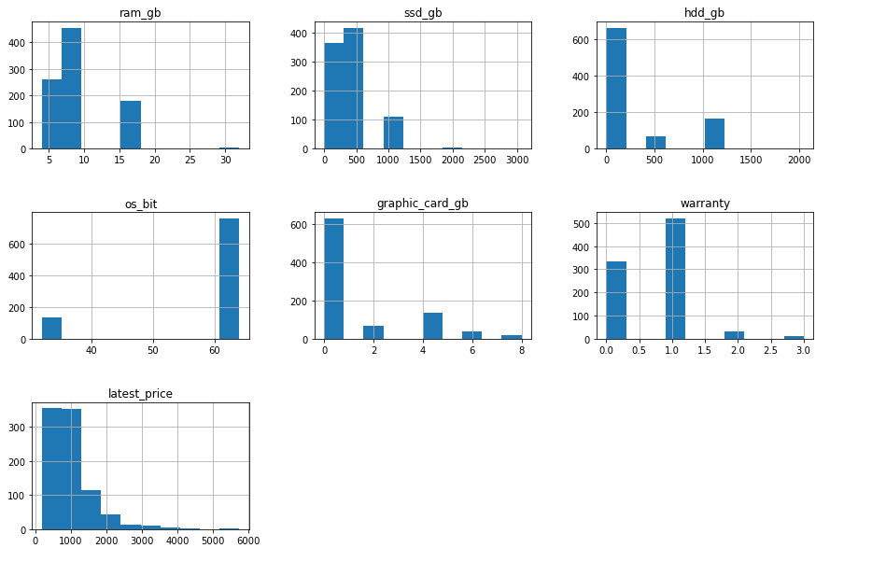
Data Wrangling
GOALS: Remove unnecessary features and tidy up some data
Following columns unnecessary and dropped:
old_price
discount
reviews
star_rating
ratings
Understanding data distributions

Slide 5
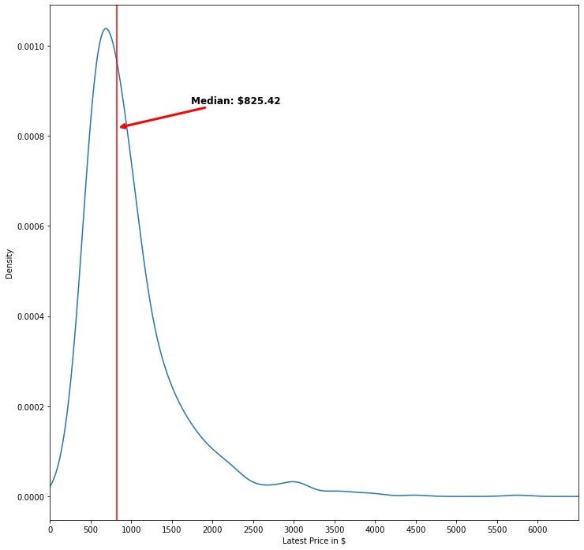
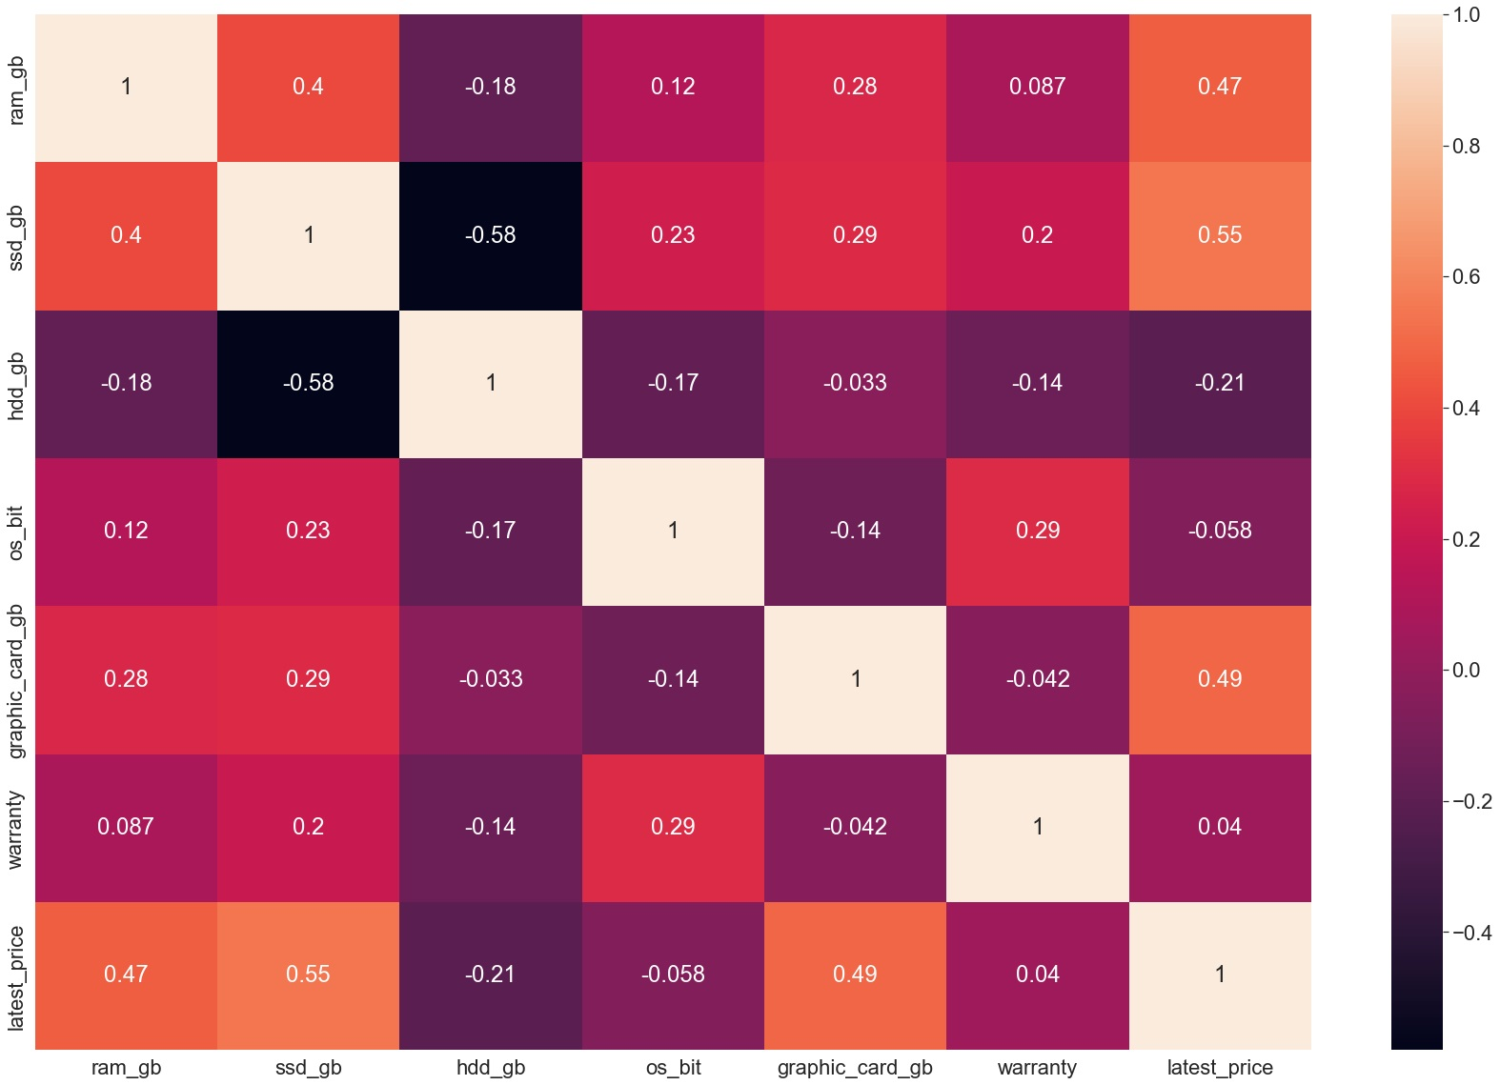
Exploratory Data Analysis
GOALS: Understand our data and building our model hypothesis
Primary Exploration - Median and Correlation
Features with correlations

Slide 6
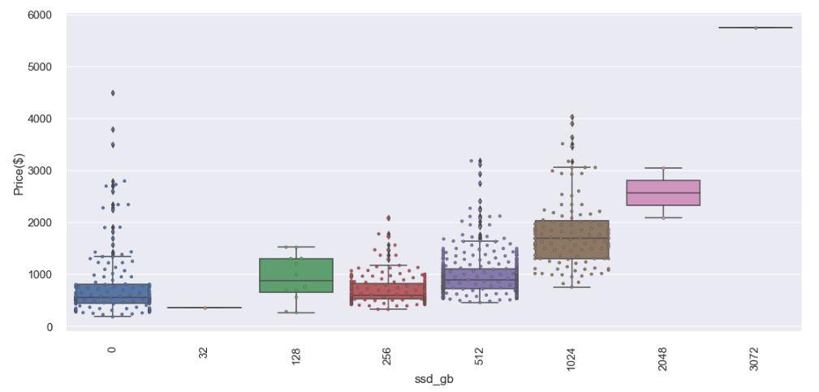
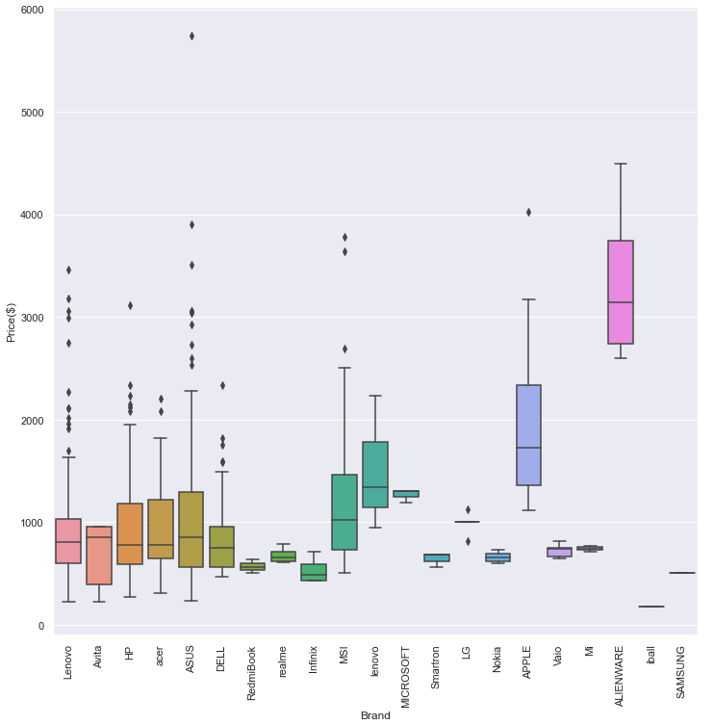
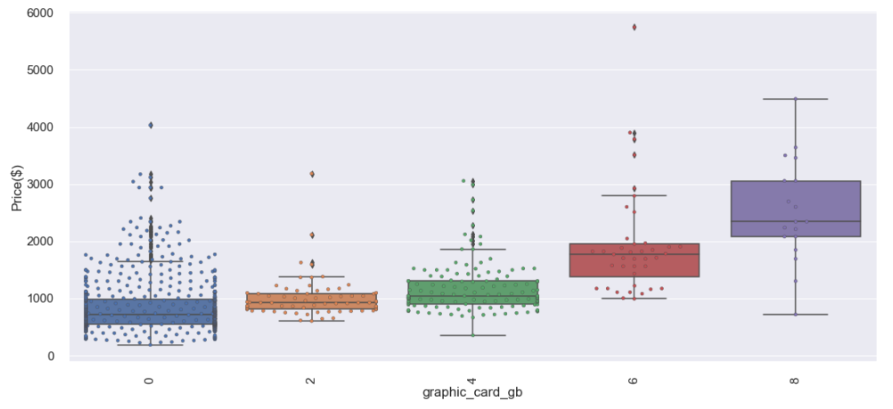
Exploratory Data Analysis
Box Plots show similarities and differences

Slide 7
Data Pre-Processing
GOAL: Make data usable for models
Remove -> “Model”: Too sparse
Impute -> display size and processor gen
MinMaxScaler with our numerical data
Dummy encode categorical data
RAM GB | SSD GB | HDD GB | Graphics Card GB | Display Size | Latest Price
Brand | Processor Brand | Processor Name | Processor Generation | RAM Type | OS | OS BIT | Weight | MS Office | Binarize Warrant

Slide 8
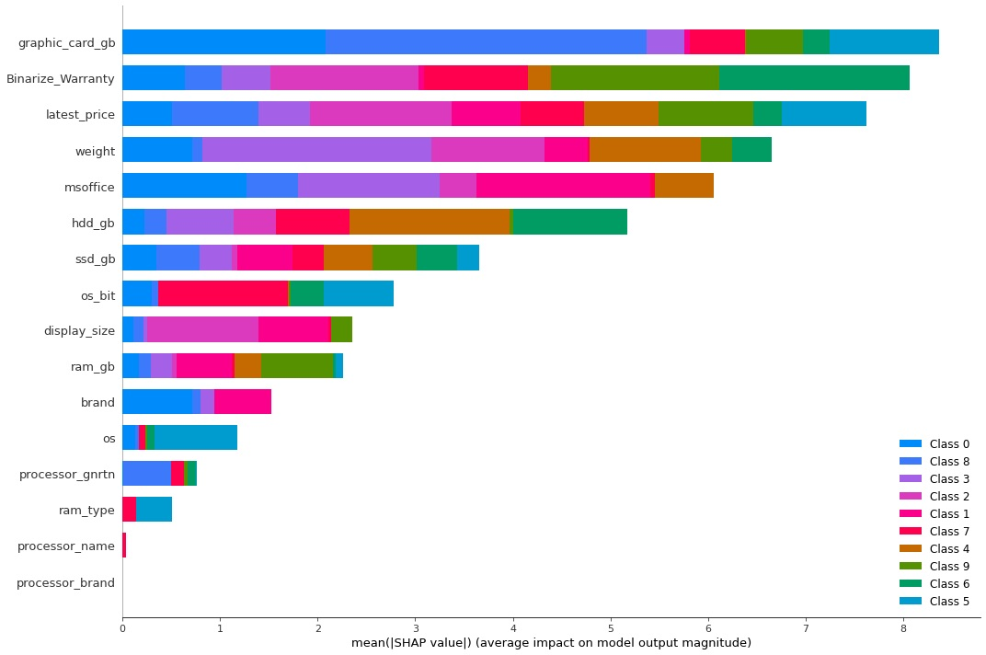
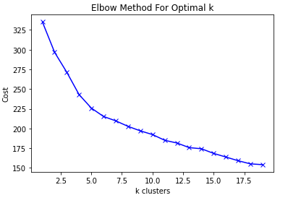
Model 1 – K-Prototypes
12 Clusters seemed ideal
SHAP Analysis helped me understand the clustering breakdown
Cost of: 191.30
F1 Score of: 0.79

Slide 9
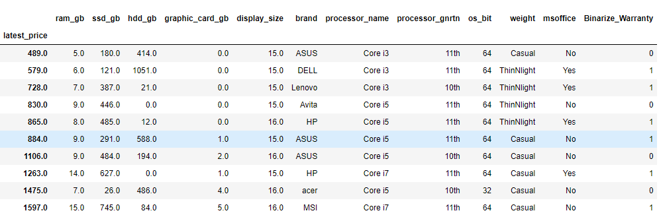
Model 1 – K-Prototypes
Assessing the clusters:

Slide 10
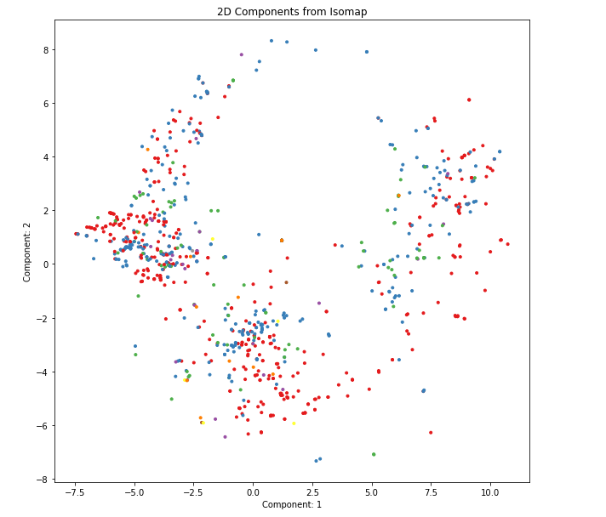
Model 2 – Isomapping
Ultimately, difficult to discern
Overlapping components without a way to understand the eigenvalues

Slide 11
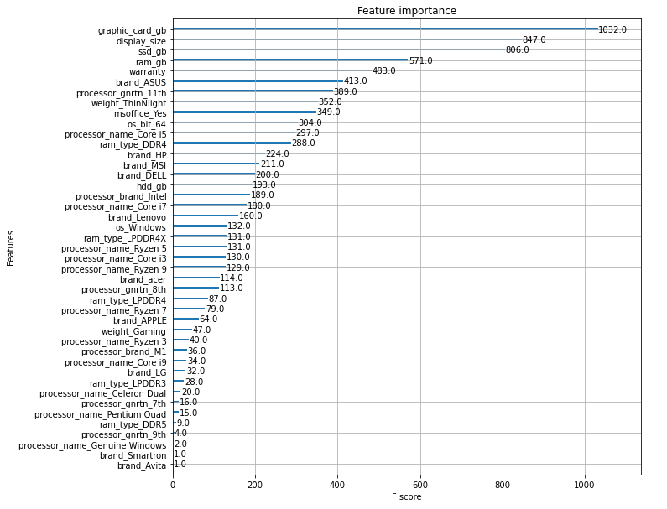
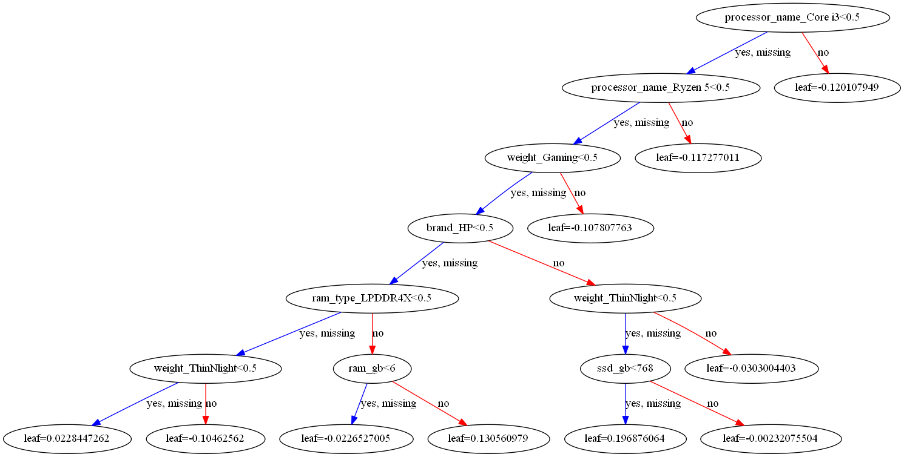
Model 3 – XGBoost
Great for understanding classification
Gave good understanding of features
Helped show important features for classification model

Slide 12
Model Decision – K-prototypes w/ XGBoost Knowledge
K-Prototypes gives easy to understand clusters
XGBoost gives great delineation between certain features
e.g if SSD above 770GB we can be confident the price should be in a higher classification group
No one model was immediately the best

Slide 13
Recommended Action
Use the K-protoypes clusters as a starting point for pricing
Use XGBoost tree for understanding exactly which price range it should fall in -> can label a laptop based on inputted specifications
Focus on developing graphics card memory size, SSD size, display size, and providing warranties
These are the main ways to optimize our pricing strategy

Slide 14
Constraints and Limitations
Initially missing a lot of data (almost 33%)
Assuming that all features are weighed the same
Relatively small dataset compared to the volume of laptops available
Potentially could become outdated without updated laptop information

Slide 15
Further Study
Gather more laptop data
Improve the decision tree modeling to increase accuracy
Get fewer missing data points with less imputing to minimize bias
Gather consumer data and apply weighting to our data points
Combine with NLP to understand what consumers are saying about laptops and what they feel are important features

Slide 16
Thank you
Timothy Lu
Project Report: https://github.com/naturesbless/LaptopPriceModeling/blob/main/reports%20and%20metrics/Laptop_Price_Modeling_Capstone_Report.pdf
Project Github: https://github.com/naturesbless/LaptopPriceModeling

